Slide 1

Energy Star Score Prediction Tool
Anjuli Jain Figueroa and Nathaniel Nichol January 2025

Slide 2

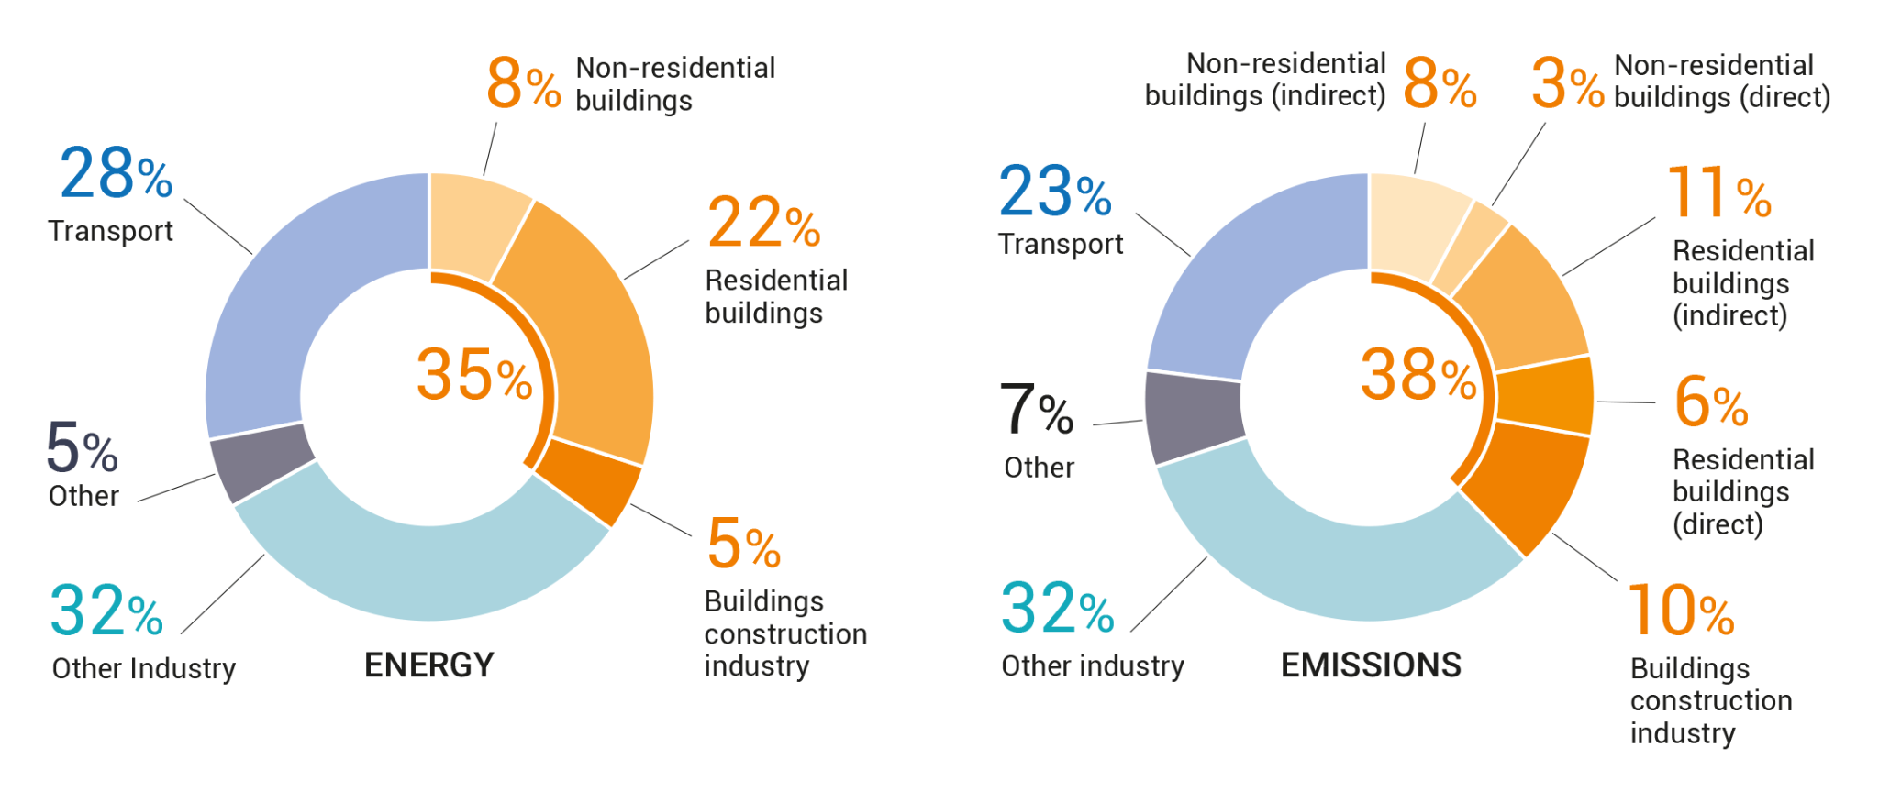
The Climate Impact of Buildings
Image Source: https://www.google.com/url?sa=j&url=https%3A%2F%2Fcoolcoalition.org%2Fnow-available-2020-global-status-report-for-buildings-and-construction%2F&uct=1717347573&usg=6XiiEsu_D-RbO__YiYuuwe2ggM4.&opi=76390225&source=meet
Notes:
UN Environment Program: https://coolcoalition.org/now-available-2020-global-status-report-for-buildings-and-construction/
38% of emissions are related to buildings, yet metrics for evaluating energy efficiency to make informed decisions in order to reduce energy consumption and ultimately emissions do not exist.
"Buildings are major energy consumers and sources of greenhouse gas emissions, yet only a handful of cities like San Francisco and New York have requirements to comply with energy efficiency benchmarking and make public the Energy Star Scores for buildings.

Slide 3

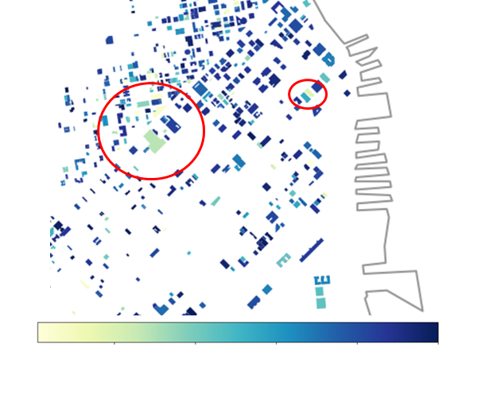
The Problem
Energy Star Score for Buildings:
Rating from 1 to 100 showing energy-efficiency of a building.
Higher scores mean more efficient.
Helps identify energy savings, cost reduction, and environmental impact.
Buildings are big energy consumers
Limited public data on efficiency
Difficult to have large targeted regional solutions
Notes:
Energy Star scores show the energy efficiency of a building but are complicated to calculate and not widely publicly available.
These scores could be used to identify energy inefficiencies and make targeted improvements. However, not every city has the resources to prioritize this, which is where we come in. Our tool, aims to use readily available satellite data to predict Energy Star Scores, even in cities where the Score data isn't available. This can help to improve energy efficiency, reduce costs, and play a part in addressing climate impact."

Slide 4
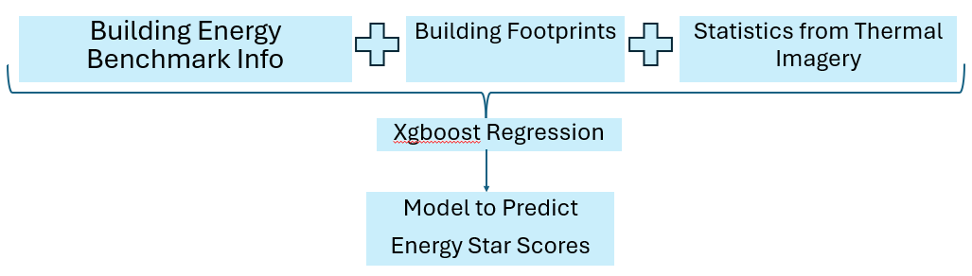
Our Solution
Leverage public satellite data to build an AI-powered tool that can predict Energy Star Scores in other buildings.
Macro Goals: Geospatial Element, Code, Start Small & Design for Scalability, Google Collab
Notes:
Our solution is an AI powered model which predicts energy star scores using publicly available data, making it easier to identify easy opportunities for energy efficiency improvements, including in historically underserved areas.
Script: "Our solution is an AI-powered tool that predicts Energy Star Scores using information about the buildings energy use and information from thermal satellite bands. It can provide valuable business insights into a building's energy efficiency and how it compares to others in the neighborhood and region. By making it easier to access energy scores, even in places that do not have very much data, building managers can lower costs and ensure compliance with energy ordinances. Our AI model consists of three parts:a code for cleaning and processing the data, a code for clipping satellite land temperature data based on building footprints, and finally, using an XGBoost model to predict the Energy Star Scores."

Slide 5
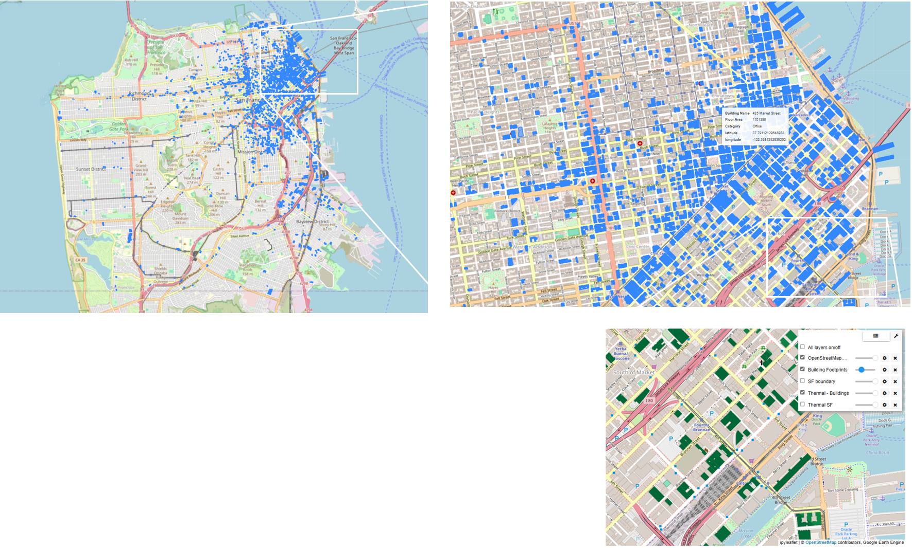

Details - The Data for San Fransisco
1- San Francisco Building Footprints
Building boundaries, Building height
2- Building Energy Benchmark Reports
Energy Use, GHG emission, Floor Area, Building Type, Year Built, Energy Star Score
3- Thermal (Satellite) Imagery Statistics
Land Surface Temperature mean, max, min, std
https://data.sfgov.org/Energy-and-Environment/Existing-Buildings-Benchmark-Reports/4ua7-5sfx/about_data
https://data.sfgov.org/Geographic-Locations-and-Boundaries/Map-of-Building-Footprints/xy57-fey9
Notes:
We combined 3 different data set (building footprint, energy use information and land surface temperature) focused on SF
When you combine multiple sources - left with fewer records
Started with 177K buildings but after combining, removing blanks and cleaning we had 854 buildings that had energy star scores
We did all the cleaning on Google Colab, used python libraries and google cloud to stream large data and get satellite data

Slide 6
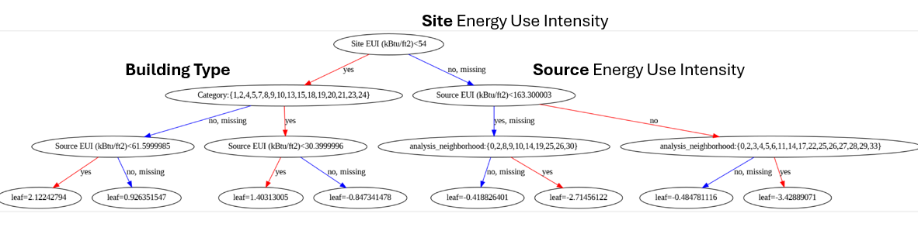
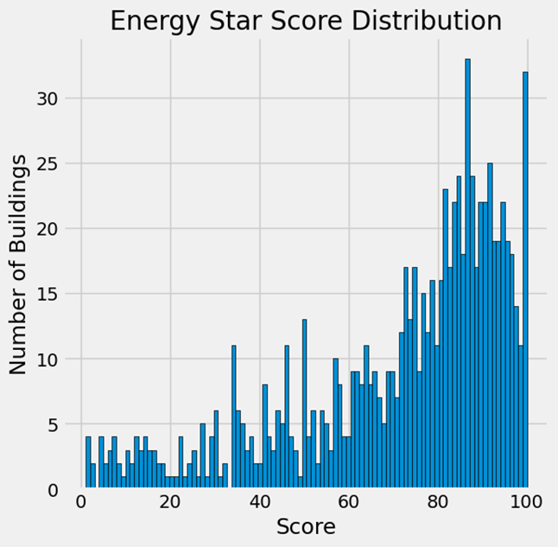
Details - The Model for Energy Star Scores
XGBoost:
18 Predictors
Regression using xgboost (decision trees, ensembles ML, gradient boosting)
Tuning parameters
Training: 683 (80%), Testing 171(20%)buildings
Python, Colab, Google Cloud, Google Earth Engine API, xgboost libraries and others
Notes:
For the AI model we used XGBoost regression to predict Energy Star Scores.
We had 18 variables as predictors
XGboost is an ensemble based decision tree with gradient boosting
if parameterized correctly it can accept both numerical and categorical values.

Slide 7

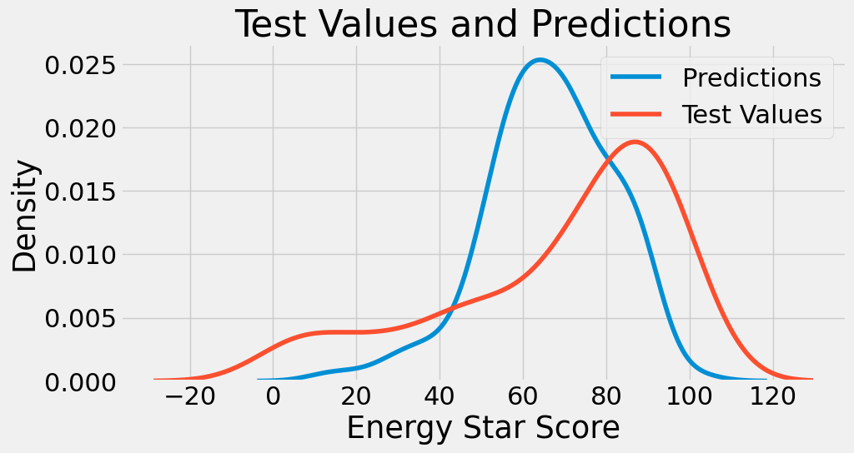
Details - The Output
R2=0.35 (0.09 before tuning)
MAE = 17.7
Biggest contributor to prediction: SOURCE energy use intensity.
Low R2 although ~4x improvement with tuning.
Energy Score was not correlated with many input variables.
None of the thermal variables from the satellite data were in the top variables.
But… we did not scale/transform and suspect that can help!
Notes:
For the result, the model fit was not great with an R2 of 0.35, however we saw 4x improvement from where we started before tuning and visually the predictions and test values have similar density distributions.
The biggest contributor to the output was source energy use intensity – building alone is not enough, need to know about the power plant that supplies it
Sadly our thermal bands did not make it in top variables
But we think there’s ways to make improvements with better choice of satellite signal.
This was a good start

Slide 8
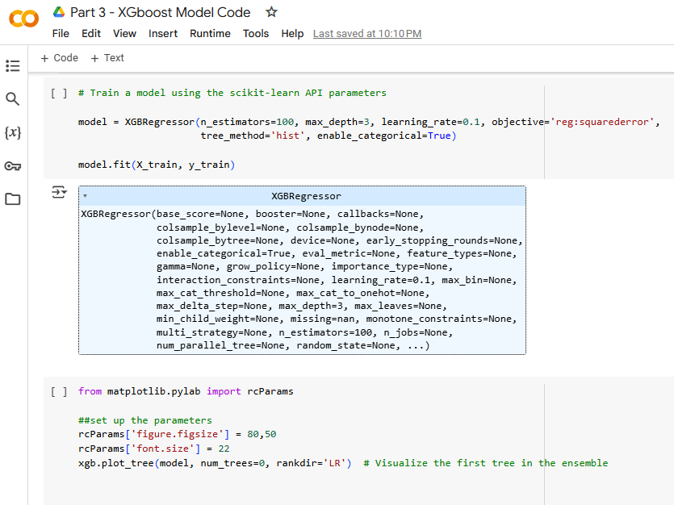
Minimum Viable Product (Code)
Part 1 - Clean and Combine SF Buildings Data (Google Collab)
Part 2 - Get Thermal Image Data and Stats for Footprints (Google Collab)
Part 3 - XGboost Model Code (Model Training and Output) (Google Collab)
Notes:
Please explore our code via the links.
Part 1 - Clean and Combine SF Buildings Data (Google Collab)
Part 2 - Get Thermal Image Data and Stats for Footprints (Google Collab)
Part 3 - XGboost Model Code (Model Training and Output) (Google Collab)

Slide 9
Next Steps
Scaling and Transformations of Numerical Values can improve fits
Use Mean Absolute Error instead of R2 to measure
Address missing Thermal satellite data statistics (max, min, and standard deviation)
Additional Training Data is needed
Consider other satellite bands
That said, still has positive potential for reducing building related GHG emissions.

Slide 10
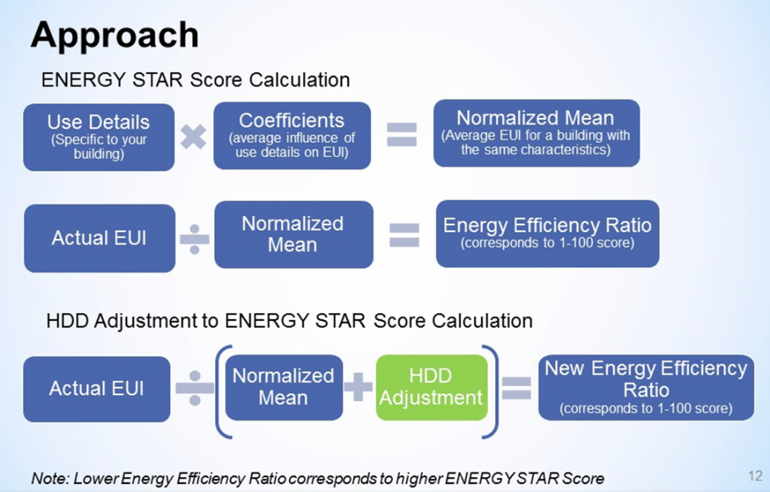
How Energy Star Score is Calculated

Slide 11
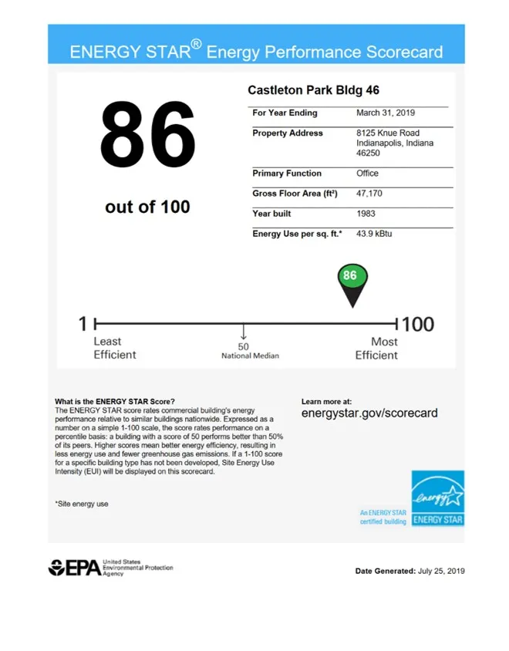
Goal: Better Prediction of Energy Star Score Data with Limited Public Data
Current → Future (AI/ML Model)
Notes:
The energy star score is a benchmarking tool used to compare the energy performance of a specific building in the US to similar buildings with similar consumption statistics nationwide.

Slide 12
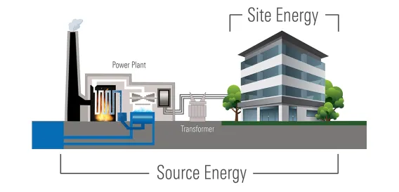
Notes:
https://www.energystar.gov/buildings/benchmark/understand-metrics/source-site-difference

Slide 13
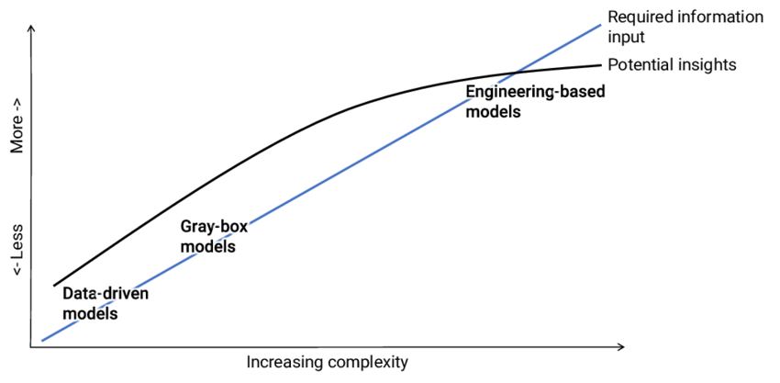
Complexity
Easy: Estimation using basic building info (size, location, usage patterns)
Hard: Highly accurate prediction (detailed usage data, operational factors).
Technology Feasibility: AI / ML is particularly suited for improving estimation & prediction accuracy.
Notes:
https://www.researchgate.net/publication/343760670_Probabilistic_Calibration_of_Building_Energy_Models_For_Scalable_and_Detailed_Energy_Performance_Assessment_of_District-Heated_Multifamily_Buildings?_tp=eyJjb250ZXh0Ijp7ImZpcnN0UGFnZSI6Il9kaXJlY3QiLCJwYWdlIjoiX2RpcmVjdCJ9fQ

Slide 14
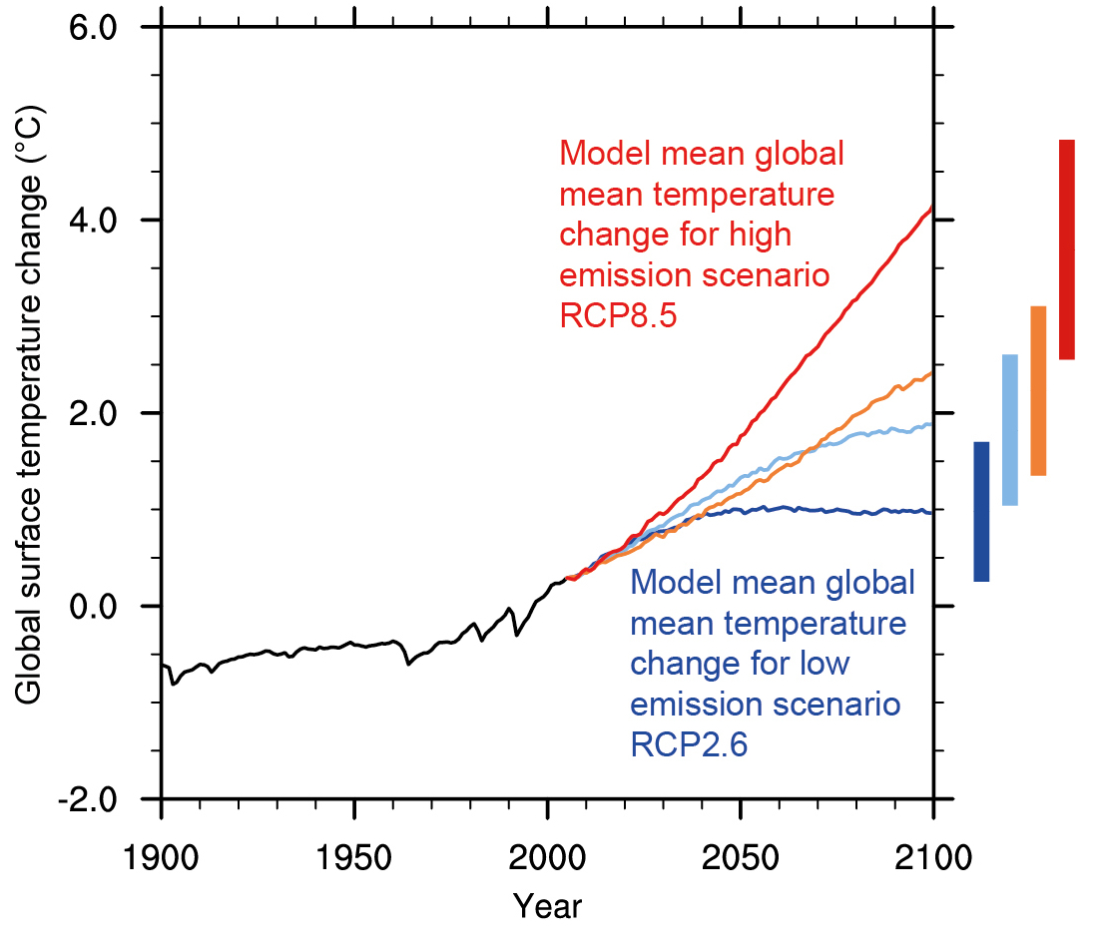
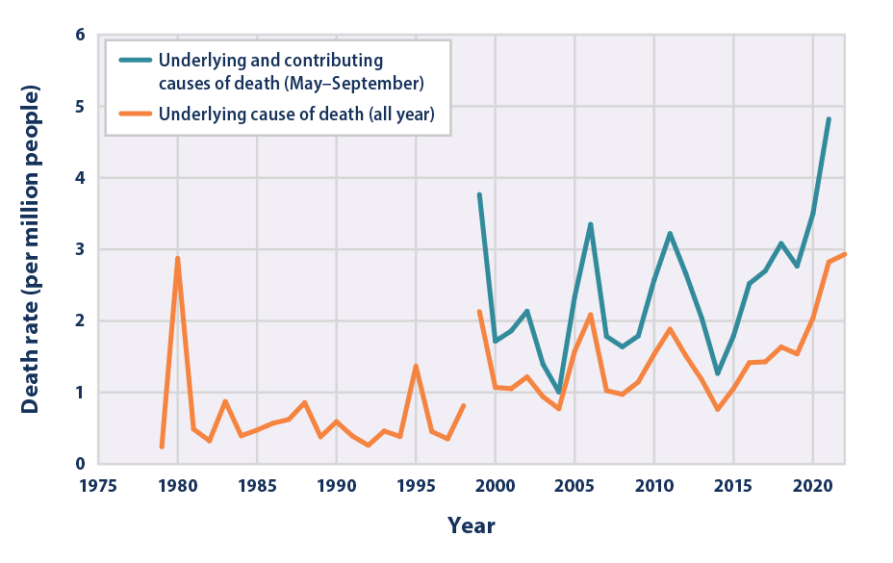
Why care about Energy Star Scores?
Notes:
They indicate how energy efficient a building is relative to others and thus can be used to compare the GHG emissions of a building. https://www.google.com/url?sa=i&url=https%3A%2F%2Fwww.epa.gov%2Fclimate-indicators%2Fclimate-change-indicators-heat-related-deaths&psig=AOvVaw1dOmtE4z6Cu7C1J4DshQpp&ust=1738110700257000&source=images&cd=vfe&opi=89978449&ved=0CBcQjhxqFwoTCKDRx4iVl4sDFQAAAAAdAAAAABAf
http://www.ipcc.ch/report/ar5/wg1/

Slide 15
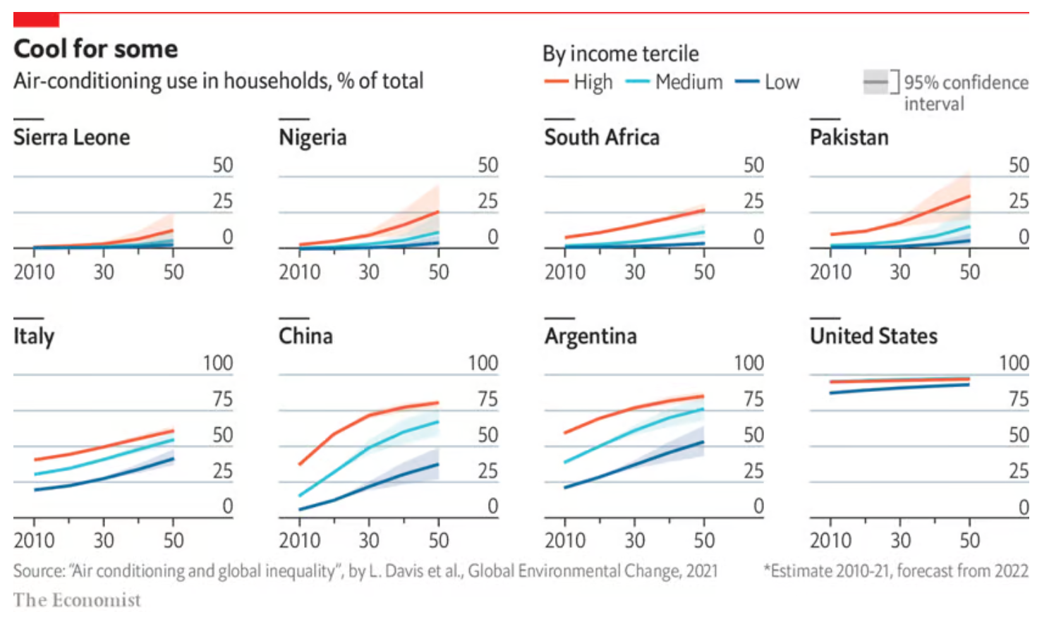
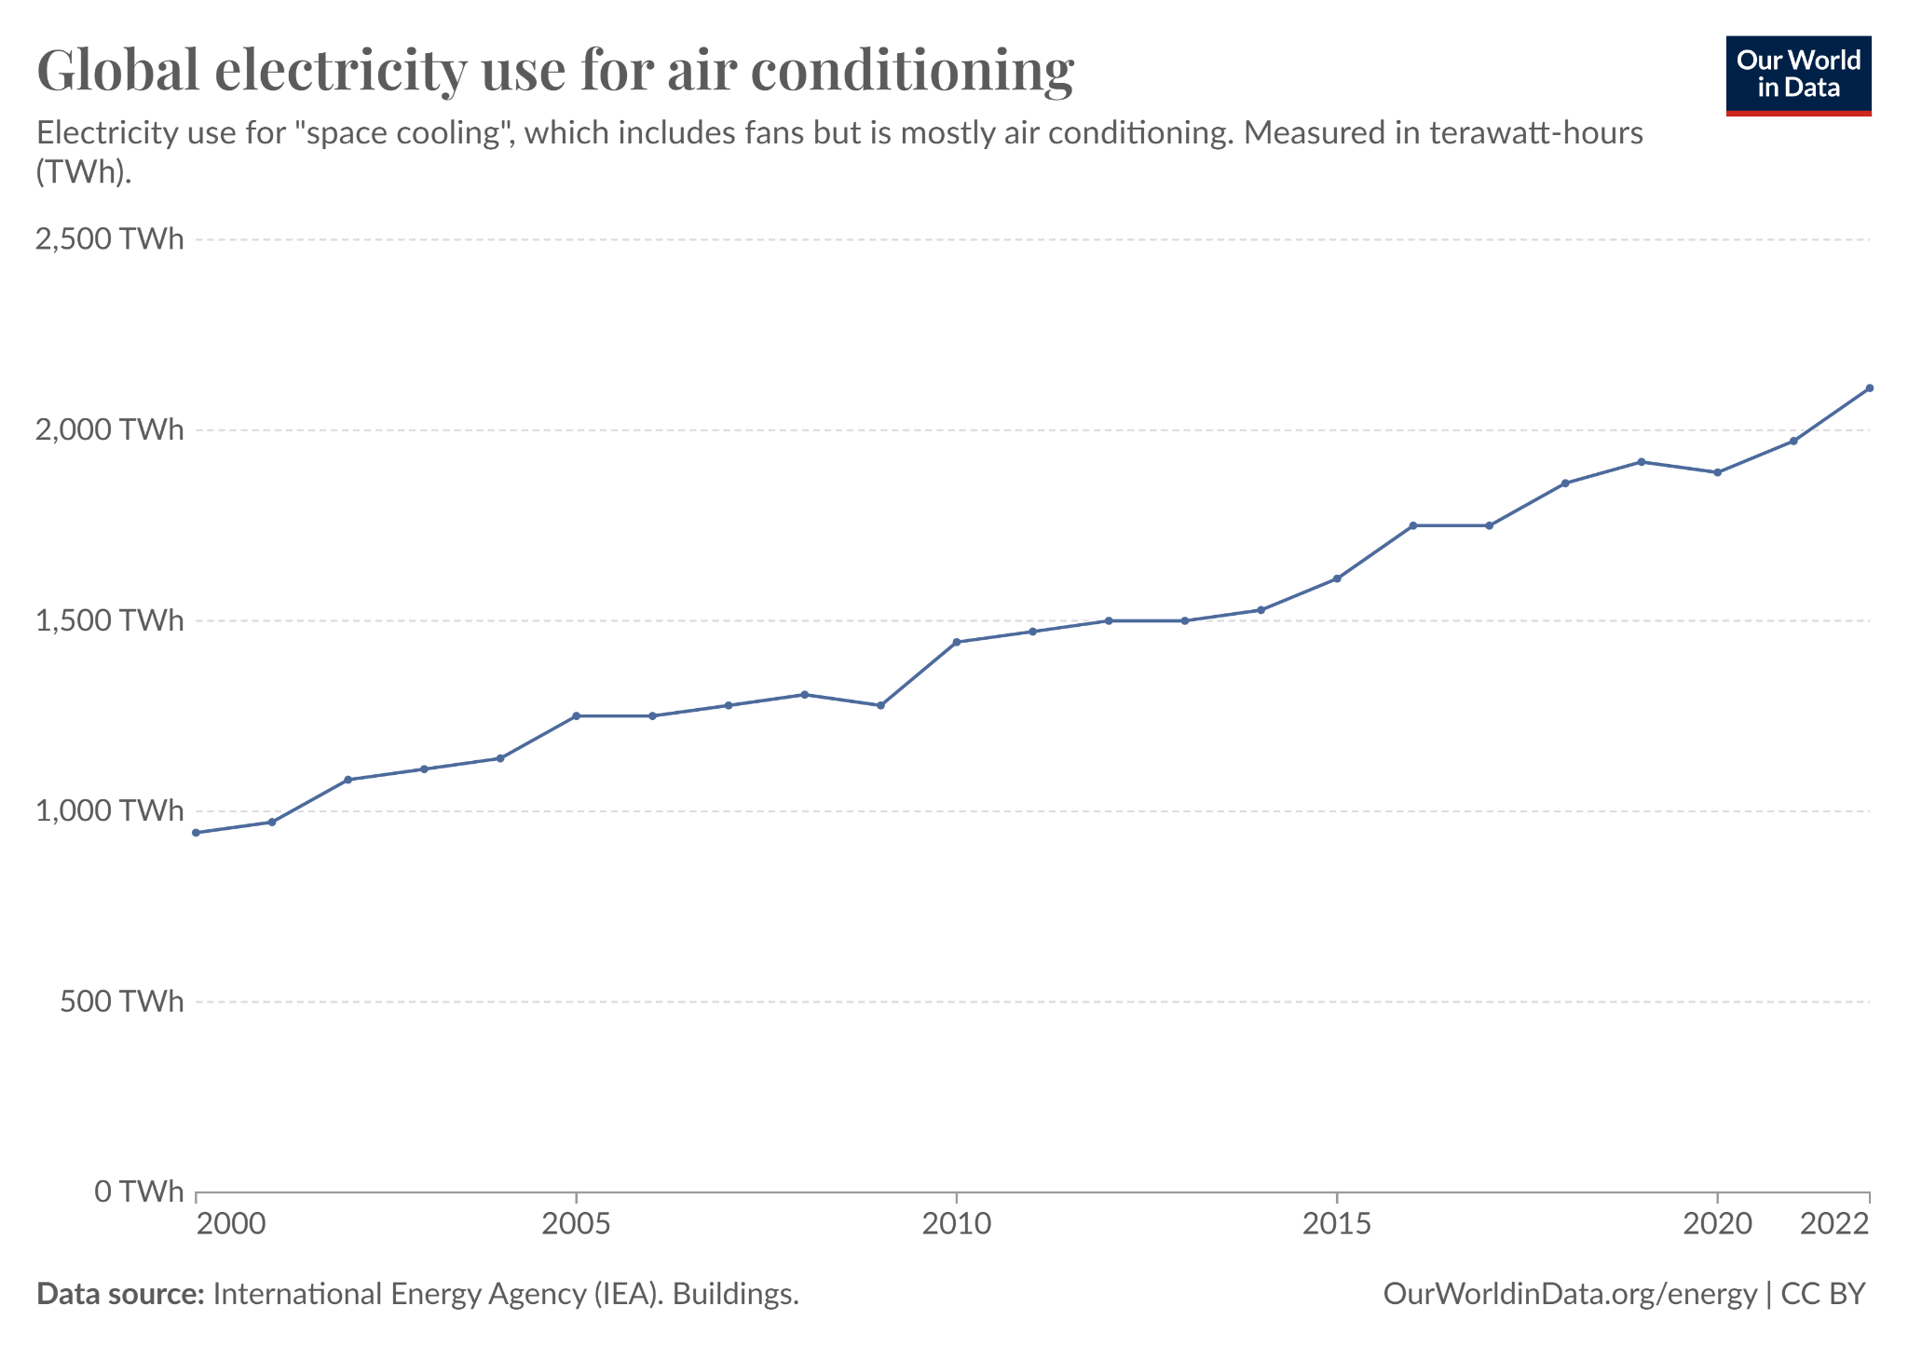
Rising Temperatures, Rising Cooling Demand
Notes:
Source 1: https://ourworldindata.org/air-conditioning-causes-around-greenhouse-gas-emissions-will-change-future
Source 2: https://www.economist.com/graphic-detail/2021/08/10/demand-for-air-conditioning-is-set-to-surge-by-2050

